Slide 1
“Cheers to Your Future”
September 14, 2022
BUMP Williams

Slide 2
BWC’s Circle of Insights
Retailer Data
Mftr. Data
Importer Data
P.O.S. Data
Industry Data
Distributor Data
Wall St./PE Data
Govt. Data
Packaging Data
Consumer Data

Slide 3
Consumer Survey Feedback
“I used to only drink Flavored Beer, never again since I found High Noon.”
“Local Craft Beer was my go-to for parties, now I bring a variety-pack of prepared Spirit drinks.”
“I didn’t consider myself a very loyal beer (brand) drinker, but now when I shop, if I can’t find my favorite spirits drink, I shop someplace else until I find it.”
“I’m not so much worried about calories or price as I am about the Quality and Taste of my drinks.”
“This is going to sound weird, but I only buy big bottles of Vodka in Glass and make my own drinks, but I will only buy the Flavored cocktails in cans.”

Slide 4
State of the Union Total US – All Off-Premise Outlets
YTD August 27, 2022
$ % Change
YAGO
EQ % Change
YAGO
Total BEER +0.4% -4.5% Imports, Flavors and Single Serve
RTD BEER -1.4% -6.9% Hard Seltzer Water Driving Decline
Total WINE -3.8% -6.6% ALL segments of Wine are in decline
RTD WINE -2.2% -5.9% 11 of Top 15 RTDs in Decline
Total SPIRITS +0.1% +2.0% Traditional Spirits Losing Occasions
RTD SPIRITS +58.1% +65.7% 14/15 Top RTDs Growing

Slide 5
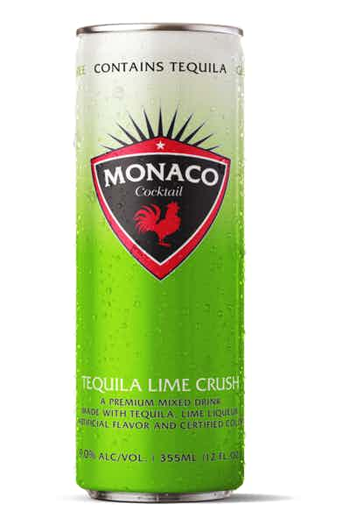
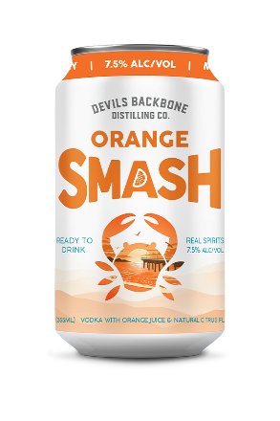
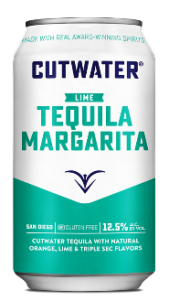
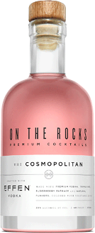
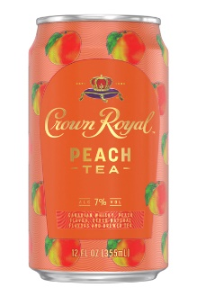
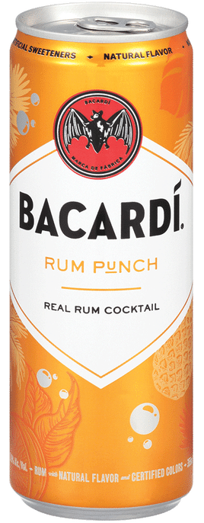
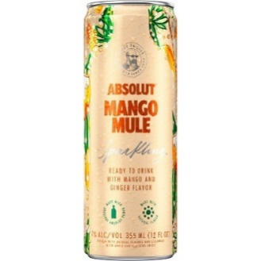
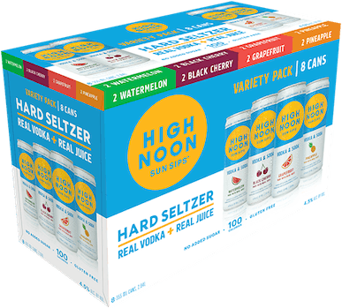
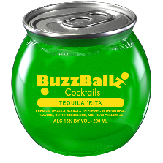
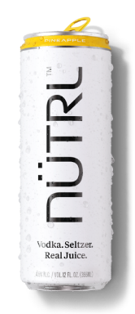
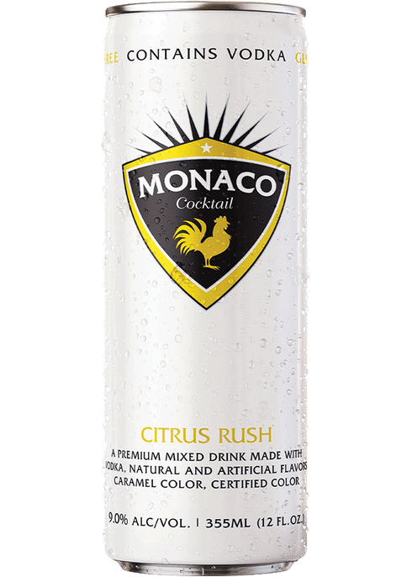
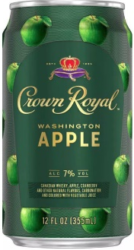
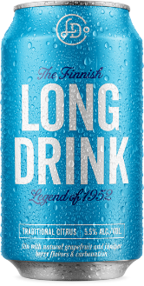
Top 10 RTD Spirits Families – CY ‘20 vs. YTD ‘21 Total US xAOC + Liquor Plus Convenience
CALENDAR YEAR 2021
71.3%
$ Shr
RTD Spirits
30.0% | 12.7% | 6.9% | 6.9% | 4.5% | 2.6% | 2.5% | 1.7% | 1.7% | 1.7%
YTD (Aug. 27), 2022
HIGH NOON is #1 and Widening Gap
71.1%
$ Shr
RTD Spirits
34.3% | 11.3% | 5.9% | 5.7% | 4.6% | 2.3% | 2.1% | 1.8% | 1.6% | 1.6%
Source: Nielsen AOD Syndicated BevAl SPIRITS | Total US xAOC + Liq Plus Conv | CYTD 34 Wks - W/E 08/27/2022

Slide 6
Top 25 NEW RTD Spirits Families & Brands ($000) Total US xAOC + Liquor Plus Convenience
Flavors
Big Brands
‘Old School’
Familiarity
Packaging
*NEW = Zero sales in Calendar Year 2021
Source: Nielsen AOD Syndicated BevAl SPIRITS | Total US xAOC + Liq Plus Conv | CYTD 34 Wks - W/E 08/27/2022

Slide 7
What’s Next?
Legislative Changes in Favor of RTD Spirits ….. <7.5% ABV
Spirits Will WIN Battle of the Throat Across Beverage Alcohol
Consumer Base Buying More Spirits and Spirits-Based RTD Cocktails on the Rise
Retailer Share of Mind at an All-Time High
Distributor Share of Mind Opening Distribution Opportunities
Shelf-Space (COLD & Warm) for Spirits-Based RTDs is Being Planned for NOW
Display Space Expanded to Accommodate RTD Spirits
Be Cautious of SKU-Mageddon...... Held Accountable to Same $ ROI as BEER!
Flavors, Variety Packs, Portable Single-Serve Packaging and QUALITY of Taste Essential
Price to Consumer Has NOT Been a Deterrent for Consumer Purchase Behavior

Slide 8
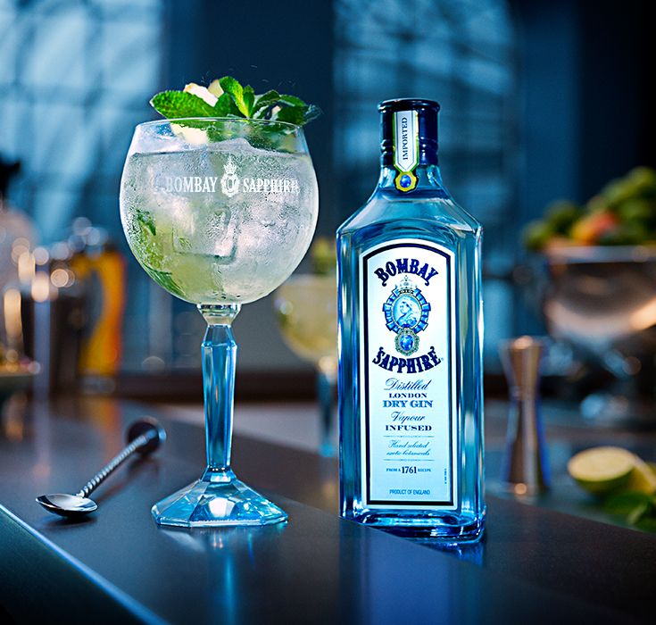
THANK YOU
BUMP Williams
bump@bumpwilliamsconsulting.com
1-203-338-1207

